Slide 1
Understanding markets: exploring marketing and market research

Slide 2
Session objectives
To define and distinguish between the concepts of market research and marketing research
To explore the purpose of research in the field of marketing.
To reflect upon the range of forms research takes and its relative purpose
To identify the stages of a typical research project
To reflect upon the ethics and limitations of research

Slide 3

Why are we looking at ‘Research’ now?
To date we have focused upon the importance of understanding both the marketing environment, customers and consumers.
This is a form of ‘market research’
Market research takes place in advance of marketing activity to inform planning
To inform TOWS
To concept test new products before launch
Market research is ongoing
To measure sentiment toward a brand
To measure success of a marketing campaign/strategy against objectives.
Market research can also be retrospective
To understand stakeholder experiences
To understand changes in demand/consumer satisfaction
To evaluate the success of a strategy or campaign against the original objectives
Understanding ‘Research’ is important for both marketing practice and your module assessment!

Slide 4

What is ‘research’? (Wilson 2014)
Research is a step-by-step process that involves the collecting, recording, analysing and interpreting of information.
It involves a process of enquiry and investigation
It is systematic and methodical
It increases knowledge

Slide 5

Defining market and marketing research…
Market Research
Focuses upon the characteristics of a specific market and the actors/stakeholders associated with it.
i.e. market size, brand shares, growth rates, saturation

Slide 6
Defining market and marketing research…
Market Research
Focuses upon the characteristics of a specific market and the actors/stakeholders associated with it.
i.e. market size, brand shares, growth rates, saturation
Marketing Research
Focuses upon the potential impact of marketing activity and informs the creation and evaluation of marketing strategy.
i.e. price modelling, concept testing, promotion tracking

Slide 7
Defining market and marketing research…
Market Research
Focuses upon the characteristics of a specific market and the actors/stakeholders associated with it.
i.e. market size, brand shares, growth rates, saturation
Customer/Consumer Insight
Generates a deep understanding of drivers of choice and the factors that influence them.
i.e. segmentation, nature of needs, motivation, influences upon
Marketing Research
Focuses upon the potential impact of marketing activity and informs the creation and evaluation of marketing strategy.
i.e. price modelling, concept testing, promotion tracking

Slide 8
Why do marketers ‘research’ markets?
To inform decision making…poor decisions cost money!
Market Size and Structure
Value and volume sales
Key segments
Competition
Route to market
Use of and Attitude to Products
Awareness/attitude toward brands
Volume/frequency of purchase
Product use
Customer Satisfaction and Loyalty
Customer ratings
Competitor Set
Brand relationships
Promotion Effectiveness
Tracking
Impact of promotional activity versus objectives
Brand Impact
Awareness of brands
Relative brand values
Relative brand positioning
Drivers of choice
Pricing Effectiveness
Optimum prices
Perceptual pricing
Impact of changes in prices (elasticity)
Product/Concept Testing
Unmet needs
Attitude to new products/concepts
Likelihood to purchase
Segmentation
Structure of the market
Key characteristics that will impact consumption, behaviour or need
Hague (2022)

Slide 9
What are the different types of research?
Descriptive Research
Exploratory Research
Causal Research
Focuses upon accurately describing the variables/situation being considered
Used when little is known about a particular management problem
Focuses upon understanding the relationship between actors and entities

Slide 10

The research process: Stage 1
Defining the research problem
If the majority of cola drinkers say they prefer the taste of Pepsi, why is Coca Cola the market leader?

Slide 11

The research process: Stage 2 – Research Objectives
Defining the research problem
Formulating research objectives
What information do I have to collate in order to solve the research problem?
To understand the size and structure of the cola market in the UK
To identify the drivers of brand choice amongst cola drinkers in the UK

Slide 12

The research process: Stage 3 – Desk research
Defining the research problem
Formulating research objectives
Undertaking 'desk' research
Secondary Data Sources: data that has been collected for a purpose other than the current study.
Examples: Market reports, sales figures, previous marketing research projects,
Relatively cheap
Quick
Potential lack of relevance
May be out of date
Avoids duplication of effort/unnecessary cost
Helps set parameters of the project

Slide 13
The research process: Stage 4 – Choosing the correct methodology and method
Defining the research problem
Formulating research objectives
Undertaking 'desk' research
Choosing the correct methodology and method
Qualitative methodology
Quantitative methodology
Used to understand or explore.
Produces ‘rich’ data
Used to measure or model
i.e focus groups, depth interviews
i.e questionnaires, EPOS data, audience data, digital metrics

Slide 14
The research process: Stage 4 – Choosing the correct methodology and method
Defining the research problem
Formulating research objectives
Undertaking 'desk' research
Choosing the correct methodology and method
Mixed methods
Qual/Quant =explore then verify
Quant/Qual = measure then explore
Qualitative methodology
Quantitative methodology
Used to understand or explore.
Produces ‘rich’ data
Used to measure or model
i.e focus groups, depth interviews
i.e questionnaires, EPOS data, audience data, digital metrics

Slide 15
The Research Process: Stage 6 Choose your research ‘design’
Defining the research problem
Formulating research objectives
Undertaking 'desk' research
Choosing the correct methodology and method
Choose your research 'design'
Longitudinal research: Data is collected on a regular basis over an extended period of time.

Slide 16

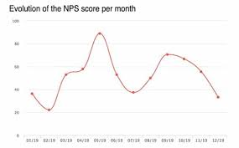
The Research Process: Stage 6 Choose your research ‘design’
Defining the research problem
Formulating research objectives
Undertaking 'desk' research
Choosing the correct methodology and method
Choosing your sampling technique
Choose your research 'design'
Longitudinal research: Data is collected on a regular basis over an extended period of time.
Yr 1…
Yr 2…
Yr 3…
Yr 4…

Slide 17
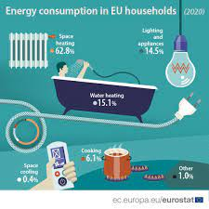

The Research Process: Stage 6 Choose your research ‘design’
Defining the research problem
Formulating research objectives
Undertaking 'desk' research
Choosing the correct methodology and method
Choosing your sampling technique
Choose your research 'design'
Cross sectional Research: Data is collected once from the sample within a specified time frame

Slide 18
Longitudinal vs Cross Sectional
Longitudinal
Cross Sectional
Allows exploration of cause and effect/change over time
Meaningful results can take years to become apparent
Can be expensive
Sample shrinks with time
Sample is subject to roughly the same conditions
Timely results
Difficult to measure cause and effect

Slide 19

GIGO… GARBAGE IN, GARBAGE OUT…
The quality of the evidence that you base your decisions upon is only as good as the quality of the research undertaken…
…so, it’s important to get it right!

Slide 20
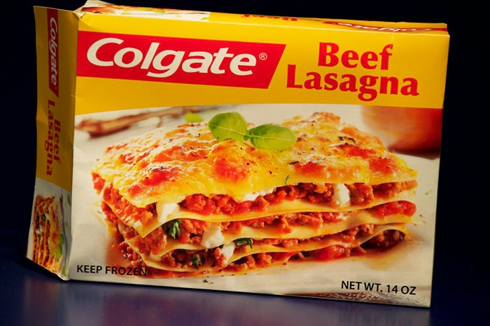
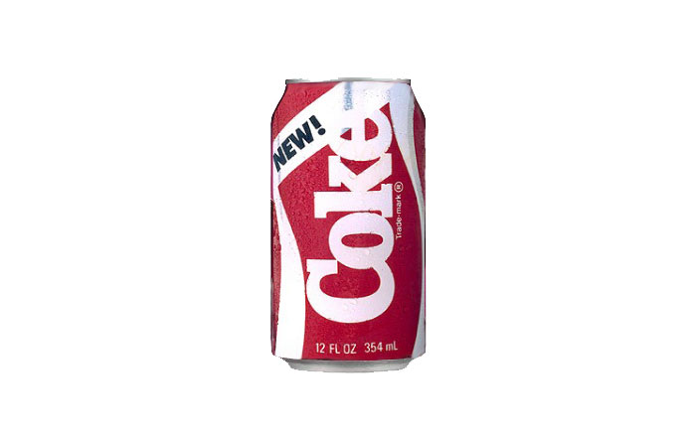
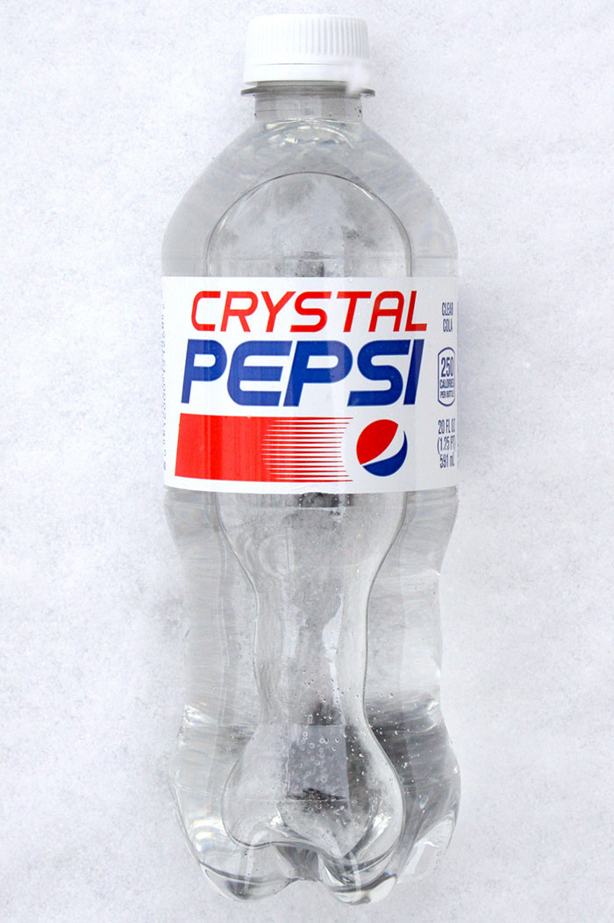
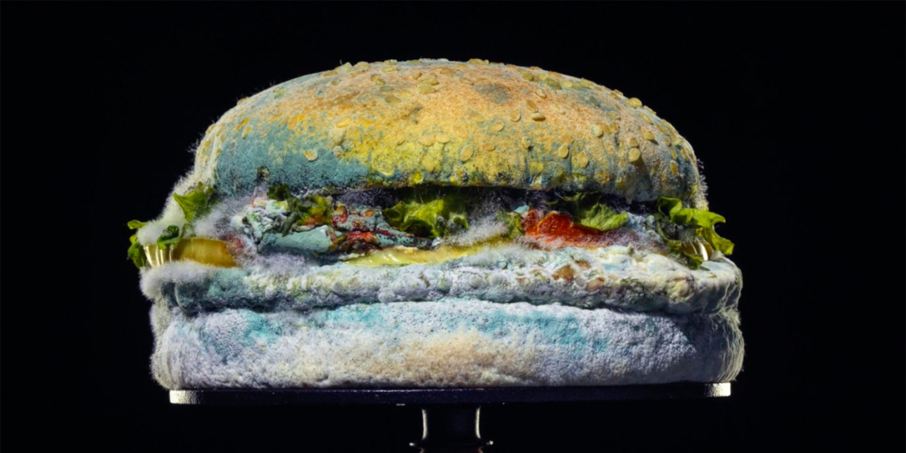
They should have researched it (better)…
Notes:
In 1985 Coca-Cola Co. decided to reformulate Coke. The company invested $4 million into a nationwide taste test. And despite the New Coke doing well in taste tests, after the launch, people's reactions were extremely negative. Within three months of the New Coke's release, the company had to reintroduce the original formula and rebrand it as Coca-Cola Classic.
In 1992 Pepsi introduced a new product called "Crystal Pepsi". The product died a year later. David C. Novak, who is credited with introducing the concept, admitted: "It would have been nice if I'd made sure the product tasted good.”
In 1982 Colgate came up with the weirdest brand extension idea. They decided to sell frozen dinners. This plan backfired, probably because consumers couldn't help but think that the Colgate food tasted just like their toothpaste. No company launches a product thinking that it will decrease sales of their other products, but Colgate should've seen it coming. Their toothpaste sales plummeted after the launch of the kitchen entrees line.

Slide 21
Summary
We have established the importance for marketers to understand their markets
Marketing research, market research and consumer insight approaches are an essential part of marketing
Understanding consumers’ needs and wants to inform product and brand development
Understanding the characteristics of the market to inform TOWS
In order to be of value, the right market research approach (defining objectives, choosing design, selecting sample etc) must be selected.
Bad research results in bad (and expensive) decision-making.

